Slide 1

XDP Based Firewall for Linux
Efe Tuna Can – Infrastructure Security

Slide 2

eBPF (extended Berkeley Packet Filter)
eBPF is a Linux kernel feature that makes it possible to run sandboxed programs within kernel space. eBPF extends the functionality of the operating system in a safe and controlled manner, taking advantage of the kernel's access to resources and system data without compromising on security or efficiency.

Slide 3
XDP (extended Berkeley Packet Filter)
An XDP program is an eBPF-based program that typically runs as a hook point in the NIC driver. XDP provides a mechanism to process network packets earlier and faster than is possible through the kernel’s native network stack.

Slide 4

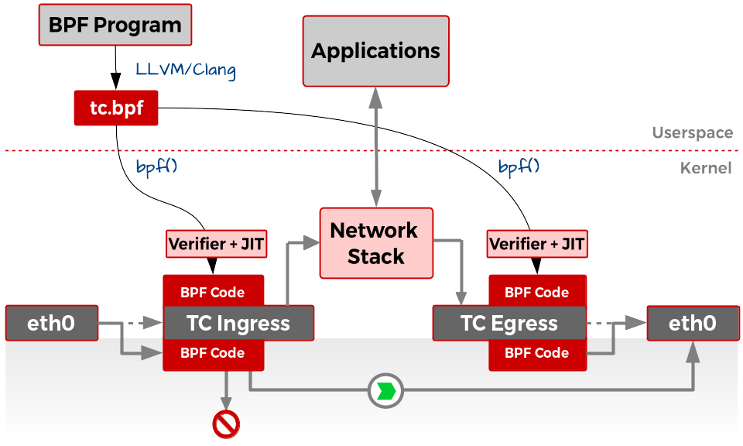

Slide 5
XDP-Based Firewall vs Traditional Firewalls
01
02
03
04
Operates directly inside the network driver
Packets are processed before they reach the network stack
Can be dynamically loaded without any need for reboot
Far more efficient and lightweight

Slide 6
PROJECT TECH STACK
RUST-AYA
RUST
01
LINUX Kernel
02
03
Robust tooling, active development
Type and memory safety

